Slide 1
Using Multi-Agent Deep Reinforcement Learning For Flexible Job Shop Scheduling Problems
Popper, Ruskowski
DFKI

Slide 2
Content
What is the SmartFactory?
Why deep learning based visual quality control?
How was it implemented?
What are the lessons learned?

Slide 3
What is the SmartFactory?

Slide 4

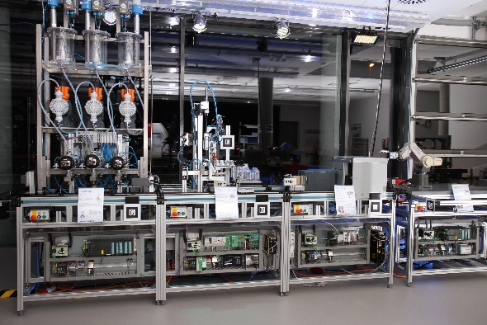
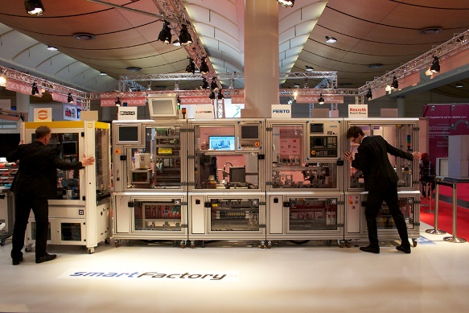
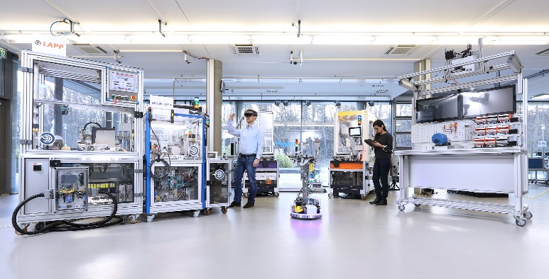
Over 50 current members
7 Founding Members
SME 4.0
Demonstrator and Testbed
Projects for research and development
2004 - 2014
2014 - 2019

Slide 5
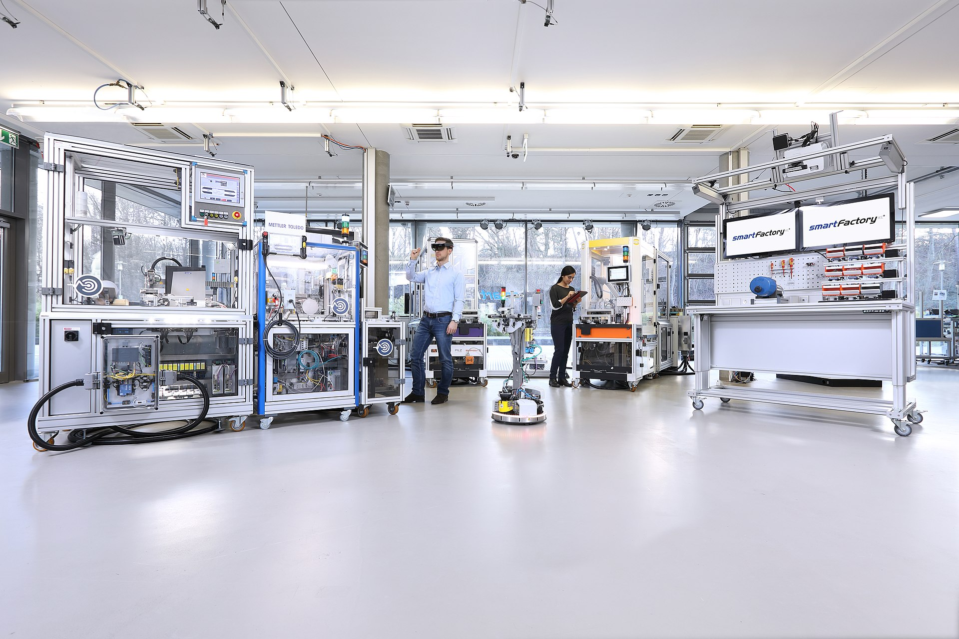
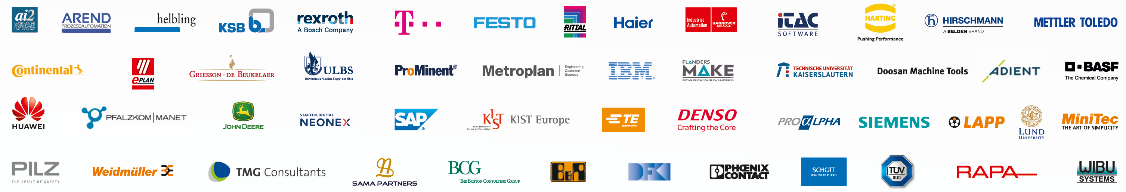

Slide 6
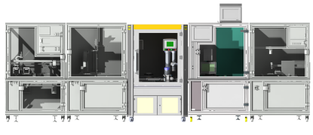





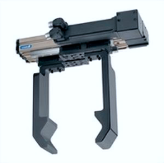


Smart factories
Smart machines
Smart objects

Slide 7
Why Deep-Learning based visual quality control?

Slide 8
Demands and difficulties resulting for smart factories…
Low lot sizes, high variety
Low setup overhead (sensors, connection broadband)
High demand for flexibility
High adaptability to new locations

Slide 9
Identified Requirements
Quality control must be carried out continuously and reliably.
II. Quality control must be able to adapt flexibly to new product variants, which may also be produced simultaneously on the same production line.
III. Quality control must be scalable and applicable to various production processes.
Identified technologies that satisfy the requirements
Deep-learning based object detection and analytics
TSN-capable network to ensure reliable communication

Slide 10
How was it implemented?

Slide 11
Implemented Hardware & Topology
Hirschmann RSPE 35 TSN switch
Huawei Prototype Switch (no further specification)
Cisco 6050 IP camera
NVIDIA Jetson TX2

Slide 12
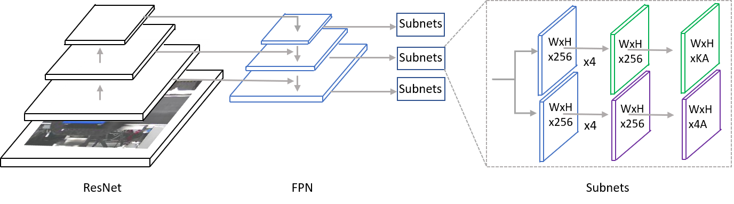
Utilized Deep Learning architecture
ResNet-50 Feature Pyramid Network shared box predictor with focal loss
Pre-Trained the COCO14 (Common Objects in Context) dataset over 50,000 steps
Trained over 100 pictures of the objects to be detected
Inference on the Nvidia Jetson TX2

Slide 13
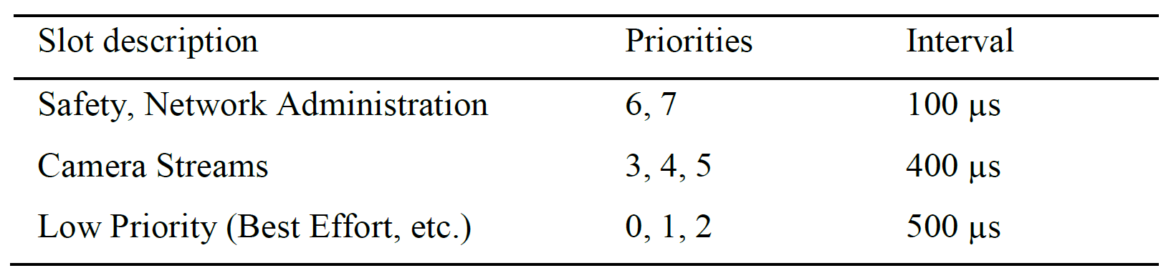
TSN Configured gate control list
Gate control list for IEEE802.1Qbv

Slide 14
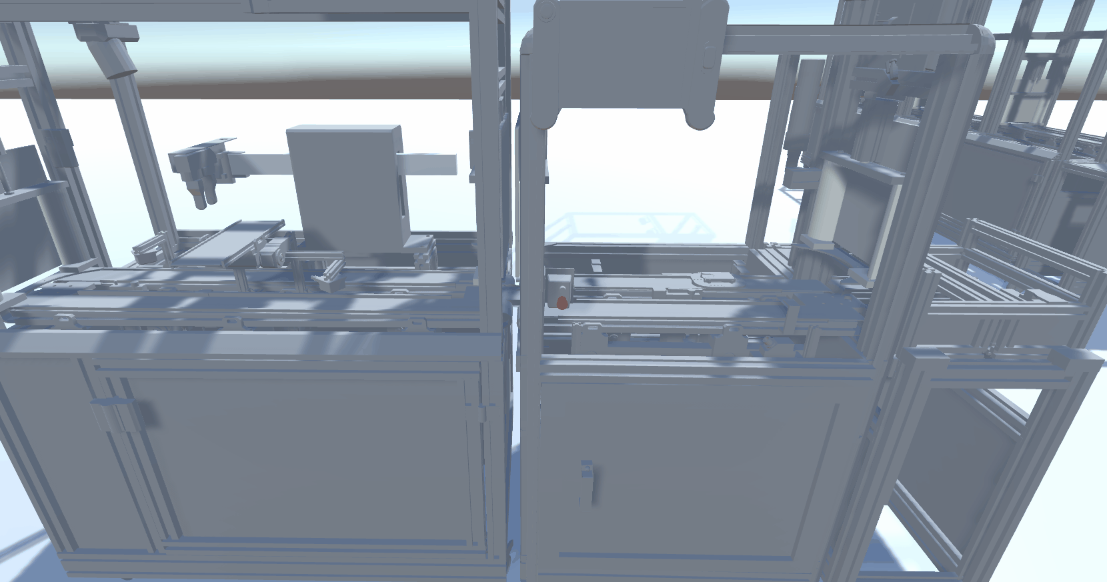

Slide 15
Lessons learned

Slide 16
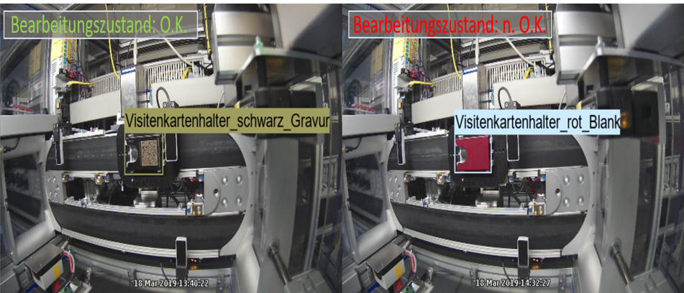
FPN-CNN implementation
Satisfied requirements of high flexibility
Able to handle camera distortions (see fisheye-lenses above)
Easy to train and deploy, even for non-experts

Slide 17
TSN lessons learned
TSN was able the guarantee determinism in network latency required for quality control
Manual configuration of the network error prone
Highly believe that automatic schedulers via a central network controller is a requirement for practical implementation in future manufacturing plants

Slide 18
Enabling reliable Visual Quality Control in Smart Factories through TSN
Popper, jens.popper@smartfactory.de
Harms, carsten.harms@dfki.de
DFKI SmartFactory

